Slide 1
Dynamic games of incomplete information
.

Slide 2
Two-period reputation game
Two firms, i =1,2, with firm 1 as ‘incumbent’ and firm 2 as ‘entrant’
In period 1, firm 1 decides a₁={prey, accommodate}
In period 2, firm 2 decides a₂={stay, exit}
Firm 1 has two types: sane (wp p) or crazy (wp 1-p)
Sane firm has D₁/ P₁ if it accommodates/preys, D₁> P₁
However, being monopoly is best, M₁> D₁
Firm 2 gets D₂/ P₂ if firm 1 accommodates/preys, with D₂>0> P₂
How should this game be played?

Slide 3
Two-period reputation game
Key idea: Unless it is crazy, firm 1 will not prey in second period. Why?
Of course, crazy type always preys. What will sane type do?
Two kinds of equilibria:
1. Separating equilibrium- different types of firm 1 choose different actions
2. Pooling equilibrium- different types of firm 1 choose the same action
In a separating equilibrium, firm 2 has complete info in second period: μ(θ=sane| a₁= accommodate)=1, and
μ(θ=crazy| a₁= prey)=1
In a pooling equilibrium, firm 2 can’t update priors in the second period: μ(θ=sane| a₁= prey)=p

Slide 4
Two-period reputation game
Separating equil:
-Sane firm1 accommodates, 2 infers that firm 1 is sane and stays in.
-Crazy firm1 preys, 2 infers that firm 1 is crazy and exits.
-Above equil is supported if: δ(M₁- D₁)≤ D₁- P₁
Pooling equil:
-Both types of firm 1 prey, firm 2 has posterior beliefs μ(θ=sane| a₁= prey)=p & μ(θ=sane| a₁= accommodate)=1, and stays in iff accommodation is observed
-Pooling equil holds if: δ(M₁- D₁)> D₁- P₁
-Also pooling equil requires: pD₂+(1-p)P₂≤0

Slide 5
Spence’s education game
Player 1 (worker) chooses education level a₁≥0
Private cost of education a₁ is a₁/θ, θ is ability
Worker’s productivity in a firm is θ
Player 2 (firm) minimizes the difference of wage (a₂) paid to player 1 and 1’s productivity θ
In equilibrium, wage offered, a₂(a₁)=E(θ|a₁)
Let player 1 have two types, θ/ & θ//, wp p/ & p//
Let σ/ & σ// be equilibrium strategies, with:
a₁/є support(σ/) and a₁//є support(σ//)
In equilibrium, a₂(a/₁)-a/₁/ θ/ ≥ a₂(a//₁)-a//₁/ θ/
and a₂(a//₁)-a//₁/ θ// ≥ a₂(a/₁)-a/₁/ θ//, implying, a//₁≥a/₁

Slide 6
Spence’s education game
Separating equilibrium:
-Low-productivity worker reveals his type and gets wage θ/. He will choose a/₁=0
-Type θ// cannot play mixed-strategy
-a₂(a/₁)-a/₁/ θ/ ≥ a₂(a//₁)-a//₁/ θ/ gives, a//₁≥ θ/(θ//-θ/)
-a₂(a//₁)-a//₁/ θ// ≥ a₂(a/₁)-a/₁/ θ//, gives a//₁≤ θ//(θ//-θ/)
-Thus, θ/(θ//-θ/) ≤ a//₁≤ θ//(θ//-θ/)
-Consider beliefs: {μ(θ/|a₁)=1 if a₁ ≠ a//₁, μ(θ/|a//₁)=0}
-With these beliefs, (a/₁=0, a//₁) with θ/(θ//-θ/) ≤ a//₁≤ θ//(θ//-θ/), is a separating equilibrium
- In fact, there are a continuum of such equilibria!

Slide 7



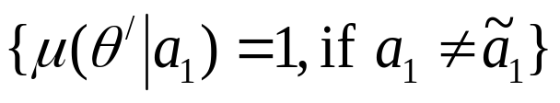


Spence’s education game
Pooling equilibrium:
-Both types choose same action,
-The wage is then
-Consider beliefs,
- With these beliefs, is the pooling equil education level iff for each θ,
θ/≤

Slide 8
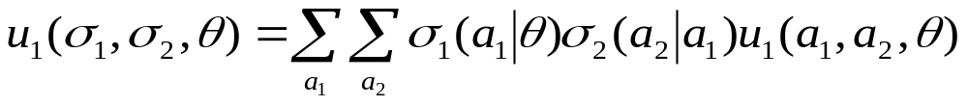
Basic signaling game
Player 1 is sender and player 2 is receiver
Player 1’s type is θєΘ, 2’s type is common knowledge
I plays action a₁є A₁, 2 observes a₁and plays a₂є A₂.
Spaces of mixed actions are A₁ and A₂
2 has prior beliefs, p, about 1’s types
Strategy for 1 is a distribution σ₁(.|θ) over a₁ for type θ
2’s strategy is distribution σ₂(.|a₁) over a₂ for each a₁
Type θ’s payoff to σ₁(.|θ) when 2 plays σ₂(.|a₁) is:
Player 2’s ex-ante payoff to σ₂(.|a₁) when 1 plays σ₁(.|θ) is:

Slide 9
Idea behind Perfect Bayesian equilibrium
Since 2 observes 1’s action before moving, he should use this fact before he moves
Thus 2 should update priors about 1’s type p to form posterior distribution μ(θ|a₁) over Θ
This is done by using Baye’s rule
Extending idea of subgame perfection to Bayesian equil requires 2 to maximize payoff conditional on a₁.
Conditional payoff to σ₂(.|a₁) is

Slide 10
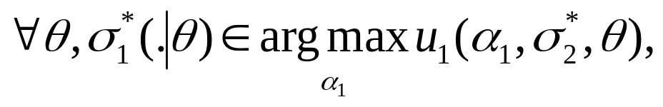
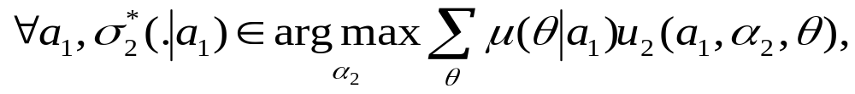
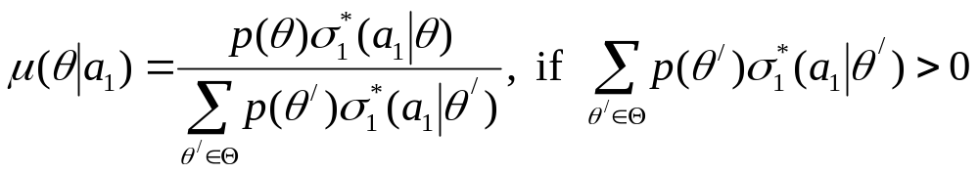
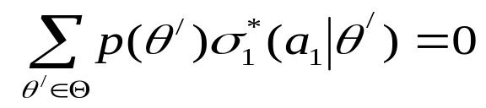
Perfect Bayesian Equilibrium
A PBE of a signaling game is a strategy profile σ* and posterior beliefs μ(|a₁) such that:
1.
2.
3.
and μ(|a₁) is any probability distribution on Θ if

Slide 11


The repeated public good game
Two players i=1,2 decide whether to contribute in periods t=1,2
The stage game is
Each player’s cost c_{i} is private knowledge
It is common knowledge that c_{i} is distributed on
[ , ] with distribution P(.). Also, <1<
The discount factor is δ
1 \ 2 | Contribute | Not contribute
Contribute | 1-c₁, 1-c₂ | 1-c₁, 1
Not contribute | 1, 1-c₂ | 0, 0

Slide 12
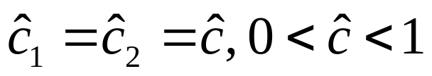
The repeated public good game
One shot game:
-The unique Bayesian equilibrium is the unique solution to c*=1-P(c*)
-The cost of contributing equals probability that opponent won’t contribute
-Types c_{i} ≤ c* contribute, others don’t
In repeated version, with action space {0, 1}, a strategy for player i is a pair (σ⁰_{i}(1| c_{i}), σ¹_{i}(1| h¹, c_{i})) corresp to 1st/ 2nd period prob of contributing where history is h¹ є {00, 01, 10, 11}
In period 1, i contributes iff c_{i} ≤ c^. In a symmetric PBE

Slide 13

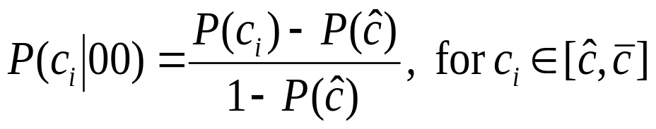
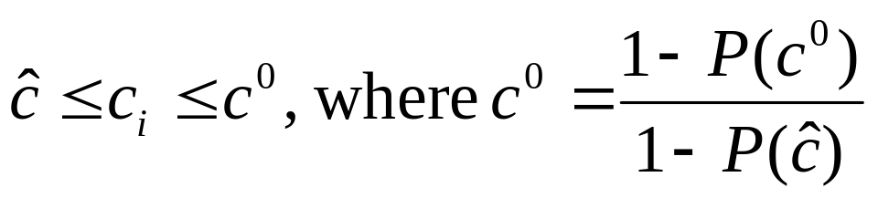
Analysis of second period
Neither player contributed:
-Both players learn that rival’s cost exceeds
-Posterior beliefs are
and P(c_{i} |00)=0 if c_{i} ≤ c^ .
-In a (symm) 2nd period equil each player contributes iff
-In period 2, type contributes if no one has contributed in period 1. utility is v⁰⁰( )=1-

Slide 14
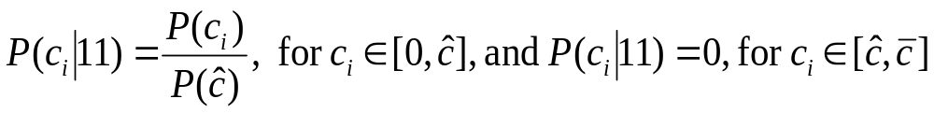
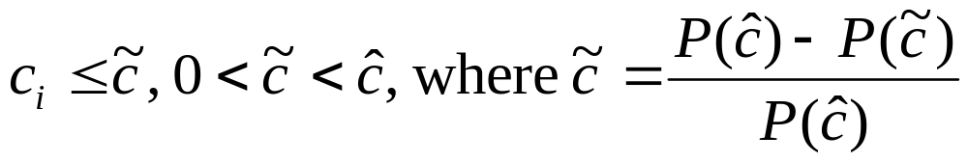
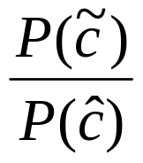
Analysis of second period
Both players contributed:
-Posterior beliefs are
-In a (symmetric) 2nd period equil each player contributes iff
-Type does not contribute. So his 2nd period utility is v¹¹( )=

Slide 15
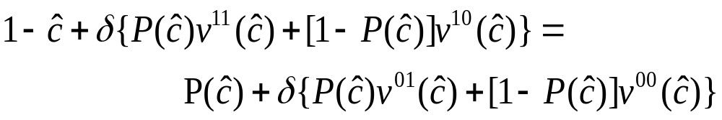
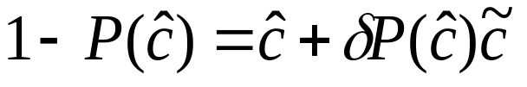
Equilibrium of the game
Only one player contributed:
-Suppose i contributed and j did not.
-Then, c_{i} ≤ and c_{j} ≥
-The 2nd period utilities of type are v¹⁰( )= 1-
and v⁰¹( )= 1
Analysis of 1st period equilibrium
-Type must be indifferent between contributing and not. Thus,
- This gives,

Slide 16
Sequential equilibrium: Preliminaries
Finite number of players i=1,…,I and finite number of decision nodes xєX
h(x) is info set containing node x, and player on move at h is i(h)
Player i’s strategy at x is σ_{i}(.|x) or σ_{i}(.|h(x)), and σ=(σ₁,…, σ_{I})єΣ is a strategy profile
Let p be probability dist over nature’s moves
Given σ_{i}, P^{σ}(x) and P^{σ}(h) are prob that node x and info set h are reached (P’s depend on p)
μ is system of beliefs. μ(x) is prob that i(x) assigns to x conditional on reaching h
u_{i(h)}(σ|h, μ(h)): utility of i(h) given h is reached, beliefs are given by μ(h), and strategies are σ

Slide 17
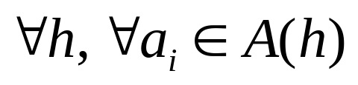
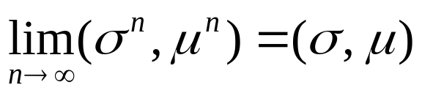
Sequential equilibrium
1. An assessment (σ, μ) is sequentially rational (S) if, for any alternative strategy σ/_{i(h)},
u_{i(h)}(σ|h, μ(h)) ≥ u_{i(h)}((σ/_{i(h)}, σ_{-i(h})|h, μ(h))
2. Let Σ⁰ ={σ: σ_{i}(a_{i}|h)>0, }. If σє Σ⁰ then P^{σ}(x)>0 for all x, and so, μ(h)= P^{σ}(x)/ P^{σ}(h(x)). In other words, Baye’s rule pins down beliefs at every information set. Let Ψ⁰ ={(σ, μ): σє Σ⁰ }
3. An assessment (σ, μ) is consistent (C) if
for some sequence (σ^{n} , μ^{n})є Ψ⁰.
A Sequential Equilibrium is an assessment (σ, μ) that satisfies S and C

Slide 18
Some properties of sequential equil
“Trembles” in C yield “sensible” beliefs following probability zero events
Thus, sequential equilibrium restricts the set of (Nash) equilibria by restricting beliefs following zero probability events. These zero probability events are deviations from equilibrium behavior.
In particular, consistency restricts the set of equilibria by imposing common beliefs following deviations from equilibrium behavior
Set of sequential equil can change when an irrelevant move/strategy is added

Slide 19
Sequential equilibrium vs PBE
Theorem (Fudenberg and Tirole, 1991):
  In a multi-stage game of incomplete information, if either (a) each player has at most two types, or (b) there are two periods, then the sets of sequential equilibria and PBE coincide.

Slide 20
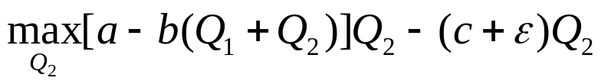
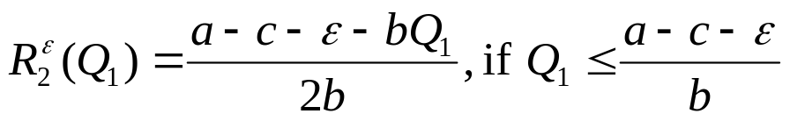
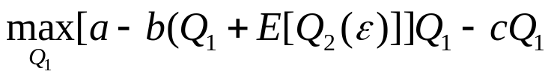
Cournot competition: incomplete info
Two firms i =1, 2, produce quantities Q₁, Q₂.
Market price is P=a-b(Q₁+ Q₂)
1’s marginal cost c is common knowledge, but 2’s cost is not known to 1: it is c+є, where є~(-Θ, Θ) with dist F(.), E(є)=0.
If є<0 (>0), firm 2 is more (less) efficient than firm 1.
To compute Bayes-Nash equilibrium:
Firm 2’s program is:
Firm 2’s best response correspondence is
1 maximizes expected profit depending on conjecture of Q₂(є)

Slide 21
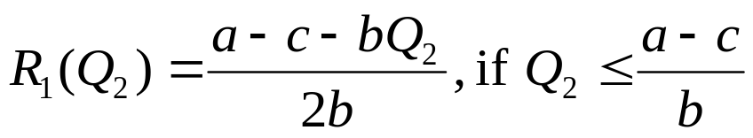




Cournot competition: incomplete info
Let us denote 2’s expected qty E[Q₂(є)] by Q₂
Firm 1’s best response correspondence is
Consider a B-N equil . In equilibrium the conjectures must coincide with the best responses
In particular, firm 1’s average conjecture E[Q*₂(є)] (≡Q*₂) about firm 2 must equal the average firm 2’s production E[R^{є}₂(Q*₁)]. Also,
Thus, in equilibrium:

Slide 22
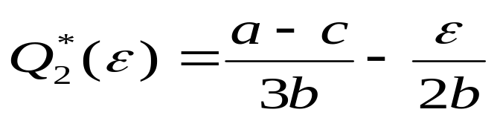
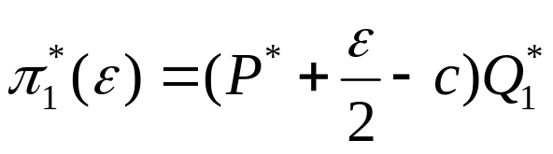
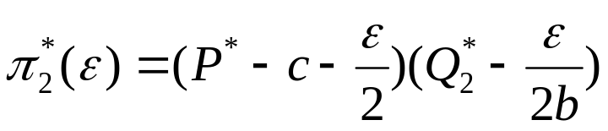
Cournot competition: incomplete info
These equations yield, Q*₁= Q*₂=(a-c)/3b
Qty produced by type є is,
The distribution of prices is P*(є)=a-b[Q*₁+ Q*₂(є)]= a-b[Q*₁+ Q*₂] + є/2 ≡ P*+ є/2, where P*= a-b[Q*₁+ Q*₂]
Profits in equilibrium are,

Slide 23
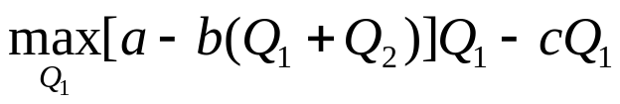

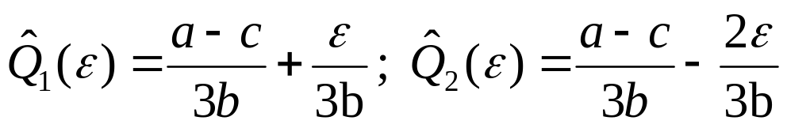
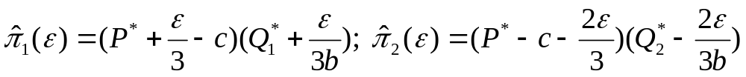
Complete info benchmark
Suppose 2’s cost is known to be c+є
Firm 2’s program is the same as before
Firm 1’s program is:
The Cournot equilibrium is
Two key differences with incomplete info case:
1. Firm 1’s qty depends on firm 2’s cost
2. For
Equil profits are
Efficient types of 2 would like their costs publicly revealed!!

Slide 24

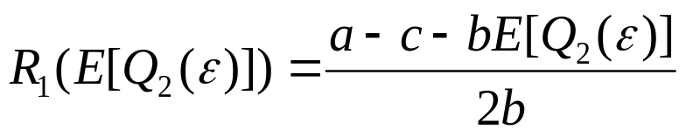
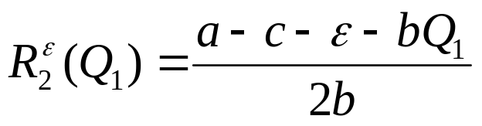

Revealing costs to a rival
Suppose firm 2 can reveal its cost, or choose not to
After revelation/ no revelation, firms compete in qty
Assume that after non-revelation, firm 1 believes she faces a type with cost larger than some
Theorem: In equilibrium, = Θ
Sketch of Proof: Fix < Θ
- Firm 1’s best response is:
- Firm 2’s best response is:
- If cost not revealed, firm 1 responds to qty produced by average type between and Θ. Let this qty be

Slide 25


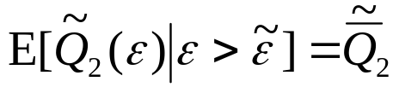
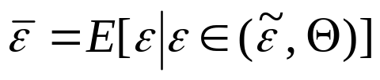
Revealing costs to a rival
Sketch of Proof:
- Let be a Bayes-Nash equilibrium
- In equilibrium the conjectures must coincide with the best responses
- In particular, firm 1’s average conjecture about firm 2 must equal the average firm 2’s production. However, the support of є for computing the expectation is now ( , Θ]
- So,
- Using, , and solving simultaneously,

Slide 26
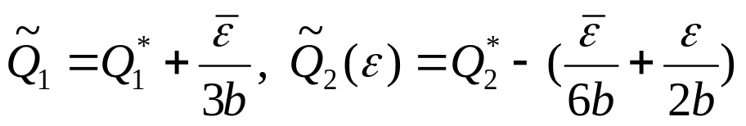
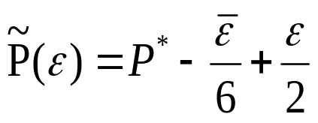





Revealing costs to a rival
Sketch of Proof:
- Equil quantities are:
- Price in equil is
- Equil profits are:
- For firms with profits are lower than in the complete info case. These firms want to reveal cost
- So without revelation, firm 1’s belief is that
- Let . By same logic as above, all types
would like to reveal. Proceeding similarly, in equil
. Thus all types of player 2 will reveal their costs !!

Slide 27
Example: Signaling willingness to pay
Suppose Sotheby’s is selling diaries of Leonardo da Vinci
Bill Gates, most promising buyer has 2 types:
-aficionado (type 1) with WTP θ
-mere fan (type 2) with WTP μ, θ>μ>0
Sotheby’s assigns probability ρ to type 1
Does Gates have a reason to signal his type?
Can he do so credibly?

Slide 28
Example: Signaling willingness to pay
Sotheby’s pricing options:
1. Set a flat price p. The price will be p=μ
2. Guarantee purchase at a higher price (say, θ/2), and sell w.p. ½ at a lower price μ (θ/2> μ)
Sotheby’s expected profit from pricing option 2 is:
ρ.(θ/2) +(1- ρ).[(1/2).μ+ (1/2).0]. Expected profit from option 1 is μ. Sotheby’s prefers option 2 if ρ> μ/(θ –μ)
Will buyers credibly reveal their types?
-Fan gets surplus μ-θ/2 with price θ/2, and surplus 0 with price μ. So prefers price μ if θ/2> μ
-Aficionado gets surplus θ/2 with price θ/2, and surplus (θ- μ)/2 with price μ. So prefers price θ/2
Yes, high-value buyer will truthfully reveal his type and pay θ/2

Slide 29
Lemons: Problem of quality uncertainty
Buyers in mkt are uncertain about quality
Seller knows true quality
Quality can be good or bad: repair cost is 200/1700 for good/bad quality
Buyer’s valuation before repairs is 3200: thus valuation for good/bad qlty is 3000/1500
Seller’s valuation before repairs is 2700: thus valuation (without selling) for good/bad qlty is 2500/1000
 | Good quality | Lemon
Net buyer valuation | 3000 | 1500
Net seller valuation | 2500 | 1000

Slide 30
Lemons: Problem of quality uncertainty
With complete knowledge both qualities would sell:
-lemon owners will sell to buyers looking for lemons: 1000<price<1500
-good qlty sellers will sell to buyers looking for good qlty: 2500<price<3000
With incomplete info, the price a buyer is willing to pay depends on probability of getting a lemon
Suppose there is equal number of lemons/good qlty
Average valuation of buyer is (1500+3000)/2=2250
Buyer will not pay more then 2250
Seller of lemon will sell, but seller of good qlty won’t
The bad drives out the good!!

Slide 31
Signaling quality through warranties
The seller of good quality can offer a warranty
Consider two extreme cases: complete warranty (100% coverage) and no warranty (0% coverage)
Payoffs with complete warranty:
-Seller only accepts prices p greater than 2700
-Payoff to lemon/good quality seller is p-1700/p-200
-Buyer’s payoff is 3200-p
-For p<2700, buyer gets 0, two types of sellers get 1000 and 2500
Payoffs without warranty:
-Lemon seller sets p>1000. Buyer/seller get 1500-p/ p
-Good quality seller sets p≥2500. Buyer/seller get
3000-p/ p

Slide 32
Signaling quality through warranties
Consider the strategy: A lemon seller offers no warranty, but a good quality seller does. Buyer bids 2700 with warranty and 1000 without
This is a separating PBE
Buyer can tell if he is bidding on a lemon, and given seller’s strategy, absence of a warranty implies a lemon
What about the two types of sellers?
-If lemon offers warranty, he gets 2700 & pays 1700 for warranty costs. So he will not switch signals
-If good quality seller offers no warranty, he gets only 1000. So he too will not switch signals

